Slide 1
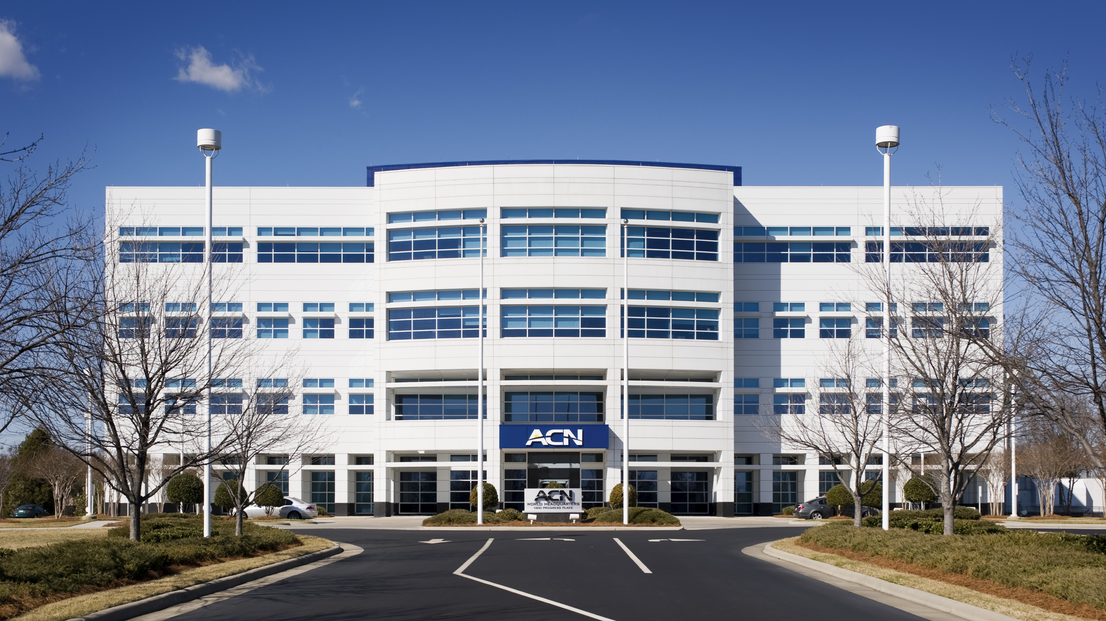

Slide 2
Refer to the ACN Compensation Plan for complete details. Earnings as an ACN IBO are based solely upon the successful sale of products to customers and their usage of those products. Individuals will incur expenses in operating their ACN business, such as the sign-up and monthly business support fees, as well as other possible operating expenses. As with any business, earnings and success at ACN are not guaranteed but depend primarily on the individual’s persistence, effort and results of acquiring customers personally and/or through their team. Individuals will not earn income and will lose money as an IBO if customers are not acquired.

Slide 3
Customer Acquisition
Specialists
Established
In 1993
Millions of
Customers Acquired
Billions
In Sales

Slide 4
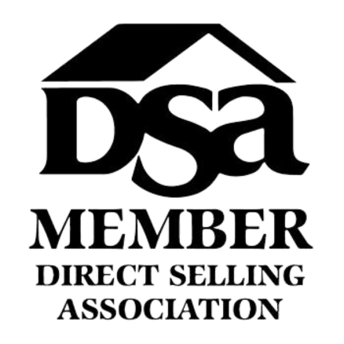
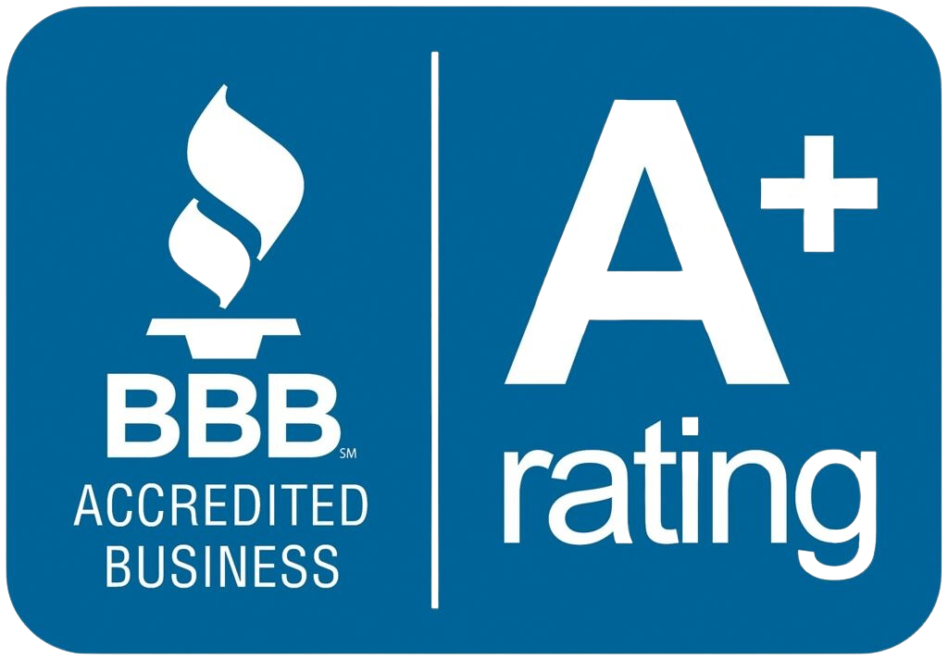
Customer Acquisition
Specialists
Established
In 1993
Millions of
Customers Acquired
Billions
In Sales

Slide 5
ESSENTIAL SERVICES
Business|Residential
WHEN A CUSTOMER IS ACQUIRED,
A CHILD IS FED.

Slide 6
EARN BONUSES
To Cover Your Services*
REFER-A-FRIEND
POWERUP
REFER-A-FRIEND
Refer 12+ XOOM Energy Residential
Natural Gas or 12+ XOOM Energy Electricity customers and receive a bonus equal to the average commodity-only charges of your customers’ bills.
Enroll & authenticate 5+ customers with an IDSeal Annual plan and receive a bonus equal to the cost of your Annual service.*
Refer 5+ Flash Mobile customers and earn a FREE** line of service.
IMAGINE HOW MUCH YOU CAN SAVE YEAR AFTER YEAR!
*Refer to the ACN Compensation Plan for complete details!
**Excludes taxes and surcharges. Terms and conditions apply.

Slide 7
BUSINESS MODEL
YOU
Most Service Providers
Media & Online Marketing
CUSTOMERS
Income Opportunity for You
More Choices for Consumers

Slide 8
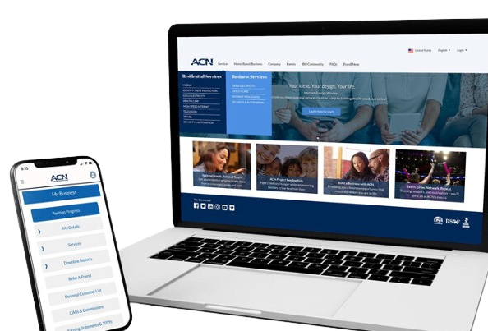
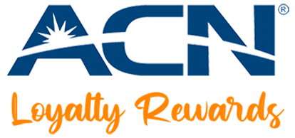
BECOME an Independent Business Owner (IBO)
$299 Start-Up + $25/month Business Support
All we do:
Personalized Website
Enroll customers
Help others to do the same thing
Training and Marketing Materials
Business Tracking and Reporting
IBO & Customer Support
ACN Loyalty Reward Program

Slide 9
Income from YOUR Personally Acquired Customers*
1
2
Monthly Customer Bonuses
Monthly Residual Income
Acquire Customers Totaling:
Earn Monthly On Your Customers
5 Services = $200
8 Services = $400
11 Services = $600
3% to 20%
Commissionable Revenue*
Plus $200
for Every Additional 3 Services*
Paid monthly on your customers Monthly Commissionable Revenue*
*Refer to the ACN Compensation Plan for complete details!

Slide 10
Income from YOUR Team’s Acquired Customers*
Overriding Customer Acquisition Bonuses
Earned once, when your team becomes customer qualified
CQ
ETL
RC
RD
RVP
SVP
SVP
Platinum
Up to
$150
Up to
$250
Up to
$350
Up to
$400
Up to
$450
$50
Overriding Residual Income
Paid monthly on customers your team enrolls
Up to
4%
Commissionable Revenue
*Refer to the ACN Compensation Plan for complete details!

Slide 11
I’m Ready To Get Started
Training & Support
ENROLL
AS AN IBO (Independent Business Owner)
Get with the person who invited you
and they’ll send you a link to their website!
PARTICIPATE
IN TRAINING
1
2
UTILIZE SUPPORT SYSTEM
ACN Online Presentations & Trainings
Your Team’s In-Person & Virtual Events
ACQUIRE
CUSTOMERS
&
BUILD A TEAM
3
4
IN BUSINESS FOR YOURSELF, NEVER BY YOURSELF!

Slide 12
Guests are welcome for all events.
New IBO Trainings are preceded by a short business overview.
The Healthcare Coverage informational Zoom will be followed by a short business overview
SUNDAY
MONDAY
TUESDAY
THURSDAY
SATURDAY
7:00 p.m. CT
7:00 p.m. CT
7:00 p.m. CT
7:00 p.m. CT
9:00 a.m. CT
NEW IBO TRAINING
HOW TO:
Get Qualified
Get Paid
Build Your Team
NEW IBO TRAINING
HOW TO:
Get Qualified
Get Paid
Build Your Team
Business Presentation
Invite Your Guests
Guests can register to attend at
HealthCoverageRedefined.com
IBOs Plug In
Every Sunday
Also great for guests!
Have a goal to have at least one guest on
each week!
New IBOs MUST be on this training as soon as they enroll!
Perfect for potential Impact customers.
Includes Q&A
New IBOs MUST be on this training as soon as they enroll!

