Slide 1
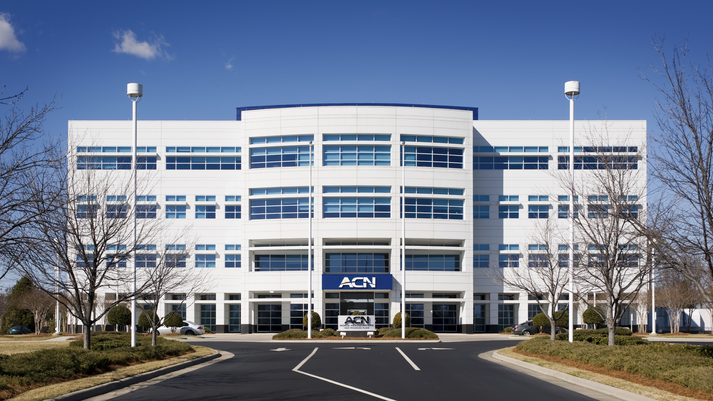

Slide 2
Refer to the ACN Compensation Plan for complete details. Earnings as an ACN IBO are based solely upon the successful sale of products to customers and their usage of those products. Individuals will incur expenses in operating their ACN business, such as the sign-up and monthly business support fees, as well as other possible operating expenses. As with any business, earnings and success at ACN are not guaranteed but depend primarily on the individual’s persistence, effort and results of acquiring customers personally and/or through their team. Individuals will not earn income and will lose money as an IBO if customers are not acquired.

Slide 3
Customer Acquisition
Specialists
Established
In 1993
Millions of
Customers Acquired
Billions
In Sales

Slide 4
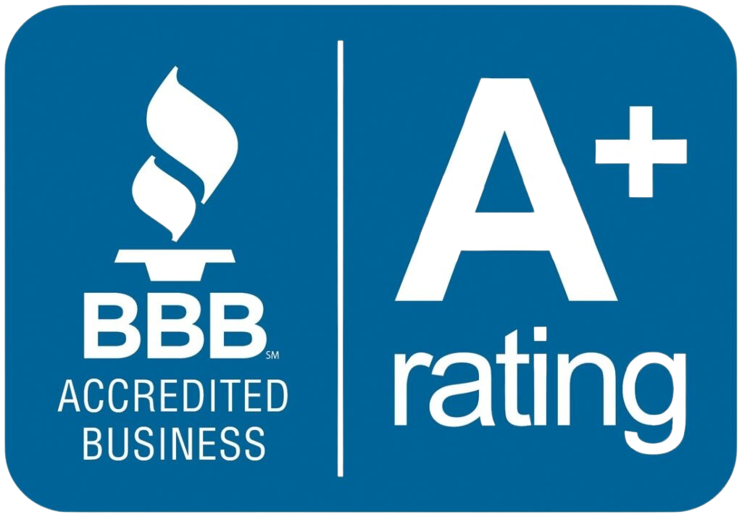
Customer Acquisition
Specialists
Established
In 1993
Millions of
Customers Acquired
Billions
In Sales

Slide 5
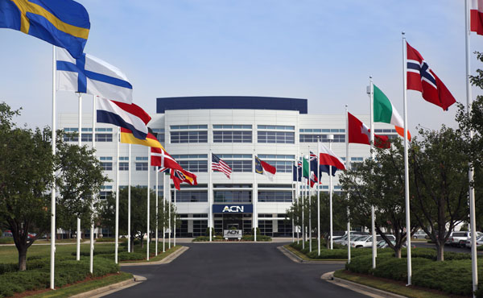
ESSENTIAL SERVICES
Residential|Business
Trusted Partners
TELEVISION
TELEVISION
ENERGY
ENERGY
HIGH SPEED INTERNET
HIGH SPEED INTERNET
HEALTH
COVERAGE
HEALTH
COVERAGE
MOBILE
MOBILE
SECURITY &
AUTOMATION
SECURITY &
AUTOMATION
CLOUD SOLUTIONS
CLOUD SOLUTIONS
PAYMENT
PROCESSING
PAYMENT
PROCESSING
PAYROLL
SOLUTIONS
PAYROLL
SOLUTIONS
TRAVEL
TRAVEL
ID THEFT
PROTECTION
ID THEFT
PROTECTION

Slide 6
Works better, feels better than insurance.
Same Care, Less Cost!

Slide 8
COMPARE THE DIFFERENCE
Traditional Health Insurance
*
High Monthly Premiums
Up to 30%-70% Savings Per Month
High Deductible Per Family Member
Annual PRA as low as $2,500 Per Household
Must Choose From a Specified Network of Physicians and Facilities
Choose Your Physician/Facility
(Not Stuck with a Network)
RX Pricing
Lower RX Pricing + Portal
Higher Co-shares, Co-Pays and Provider Fees
Lower Co-Pays, Co-Shares and Provider Fees
Extra Cost for Telehealth or Not Available
Included 24/7 Telehealth - $0 Fee
Does not cover Migrants in the US
Mexico, Guatemala and Canada with no SSN – millions of people
*See Impact Website, Pricing and Guidelines for Full Details

Slide 9
Health & Wholeness Credit
Beginning July 1, 2024
Each household can receive a credit of up to $100 monthly towards their PRA balance
DPC (Direct Primary Care) memberships
Naturopathic Medications/Supplements
Acupuncture
Services rendered by Naturopathic Providers
Gym Memberships

Slide 10
EARN BONUSES
To Cover Your Services*
REFER-A-FRIEND
POWERUP
REFER-A-FRIEND
Refer 12+ XOOM Energy Residential
Natural Gas or 12+ XOOM Energy Electricity customers and receive a bonus equal to the average commodity-only charges of your customers’ bills.
Enroll & authenticate 5+ customers with an IDSeal Annual plan and receive a bonus equal to the cost of your Annual service.*
Refer 5+ Flash Mobile customers and earn a FREE** line of service.
IMAGINE HOW MUCH YOU CAN SAVE YEAR AFTER YEAR!
*Refer to the ACN Compensation Plan for complete details!
**Excludes taxes and surcharges. Terms and conditions apply.

Slide 11
TRADITIONAL
BUSINESS MODEL
YOU
Most Service Providers
Media & Online Marketing
CUSTOMERS
Income Opportunity for You
More Choices for Consumers

Slide 12
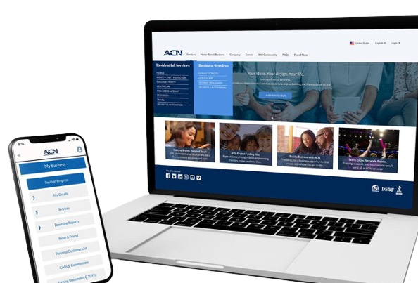
BECOME an Independent Business Owner (IBO)
$299 Start-Up + $25/month Business Support
All we do:
Personalized Website
Enroll customers
Help others to do the same thing
Training and Marketing Materials
Business Tracking and Reporting
IBO & Customer Support
ACN Loyalty Reward Program

Slide 13
Income from YOUR Personally Acquired Customers*
1
2
Monthly Customer Bonuses
Monthly Residual Income
Acquire Customers Totaling:
Earn Monthly On Your Customers
5 Services = $200
8 Services = $400
11 Services = $600
3% to 20%
Commissionable Revenue*
Plus $200
for Every Additional 3 Services*
Paid monthly on your customers Monthly Commissionable Revenue*
*Refer to the ACN Compensation Plan for complete details!

Slide 14
Income from YOUR Team’s Acquired Customers*
Overriding Customer Acquisition Bonuses
Earned once, when your team becomes customer qualified
CQ
ETL
RC
RD
RVP
SVP
SVP
Platinum
Up to
$150
Up to
$250
Up to
$350
Up to
$400
Up to
$450
$50
Overriding Residual Income
Paid monthly on customers your team enrolls
Up to
4%
Commissionable Revenue
*Refer to the ACN Compensation Plan for complete details!

Slide 15
I’m Ready To Get Started
Training & Support
ENROLL
AS AN IBO (Independent Business Owner)
Get with the person who invited you
and they’ll send you a link to their website!
PARTICIPATE
IN TRAINING
1
2
UTILIZE SUPPORT SYSTEM
ACN Online Presentations & Trainings
Your Team’s In-Person & Virtual Events
ACQUIRE
CUSTOMERS
&
BUILD A TEAM
3
4
IN BUSINESS FOR YOURSELF, NEVER BY YOURSELF!

Slide 16
Guests are welcome for all events.
New IBO Trainings are preceded by a short business overview.
The Healthcare Coverage informational Zoom will be followed by a short business overview
SUNDAY
MONDAY
TUESDAY
THURSDAY
SATURDAY
7:00 p.m. CT
7:00 p.m. CT
7:00 p.m. CT
7:00 p.m. CT
9:00 a.m. CT
NEW IBO TRAINING
HOW TO:
Get Qualified
Get Paid
Build Your Team
NEW IBO TRAINING
HOW TO:
Get Qualified
Get Paid
Build Your Team
Business Presentation
Invite Your Guests
Guests can register to attend at
HealthCoverageRedefined.com
IBOs Plug In
Every Sunday
Also great for guests!
Have a goal to have at least one guest on
each week!
New IBOs MUST be on this training as soon as they enroll!
Perfect for potential Impact customers.
Includes Q&A
New IBOs MUST be on this training as soon as they enroll!
RhinoNation.World
TheSVPSystem.com

Slide 17
ORLANDO
October 12 – 13, 2024
www.ACNElevate.com

