Slide 1
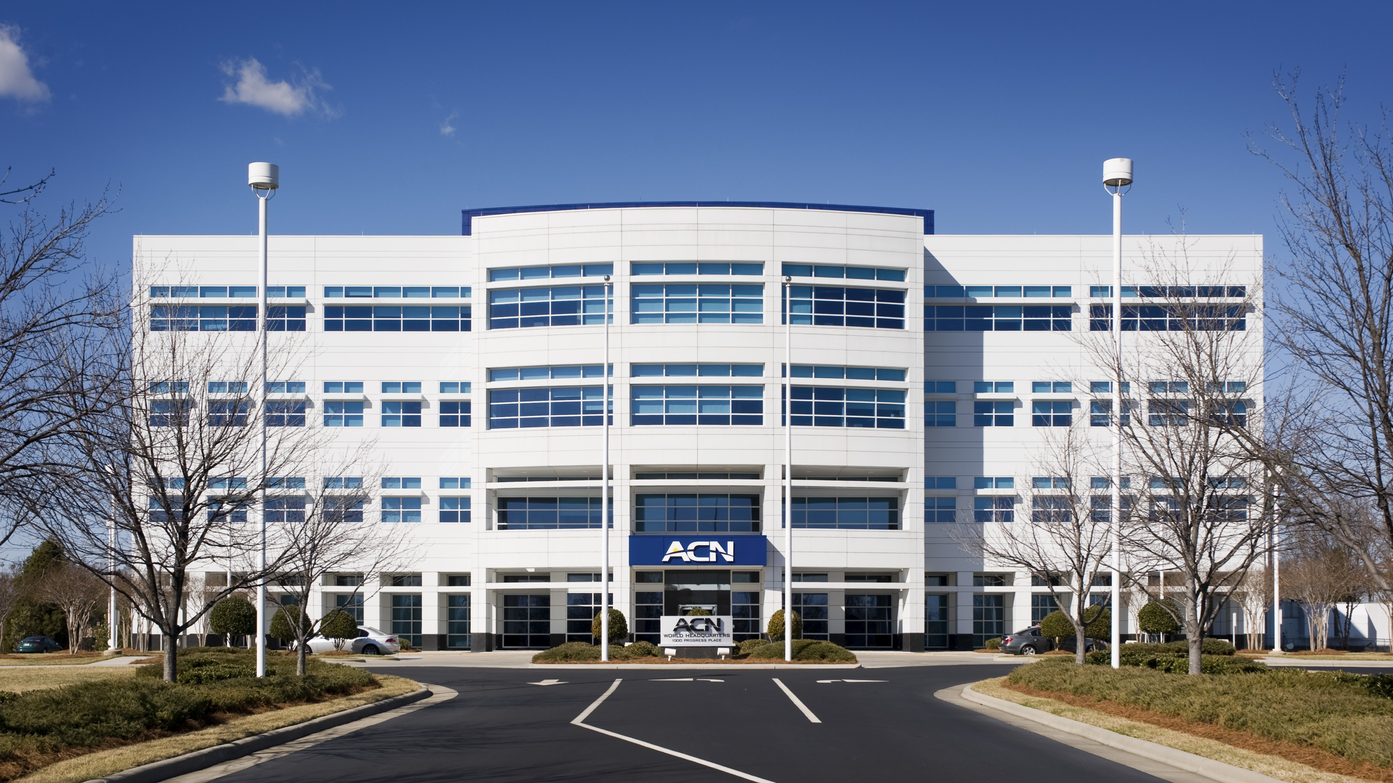

Slide 2
Refer to the ACN Compensation Plan for complete details. Earnings as an ACN IBO are based solely upon the successful sale of products to customers and their usage of those products. Individuals will incur expenses in operating their ACN business, such as the sign-up and monthly business support fees, as well as other possible operating expenses. As with any business, earnings and success at ACN are not guaranteed but depend primarily on the individual’s persistence, effort and results of acquiring customers personally and/or through their team. Individuals will not earn income and will lose money as an IBO if customers are not acquired.

Slide 3
Customer Acquisition
Specialists
Established
In 1993
Millions of
Customers Acquired
Billions
In Sales

Slide 4
Customer Acquisition
Specialists
Established
In 1993
Millions of
Customers Acquired
Billions
In Sales

Slide 5
ESSENTIAL SERVICES
Business|Residential
WHEN A CUSTOMER IS ACQUIRED,
A CHILD IS FED.

Slide 6
EARN BONUSES
To Cover Your Services*
REFER-A-FRIEND
POWERUP
REFER-A-FRIEND
Refer 12+ XOOM Energy Residential
Natural Gas or 12+ XOOM Energy Electricity customers and receive a bonus equal to the average commodity-only charges of your customers’ bills.
Enroll & authenticate 5+ customers with an IDSeal Annual plan and receive a bonus equal to the cost of your Annual service.*
Refer 5+ Flash Mobile customers and earn a FREE** line of service.
IMAGINE HOW MUCH YOU CAN SAVE YEAR AFTER YEAR!
*Refer to the ACN Compensation Plan for complete details!
**Excludes taxes and surcharges. Terms and conditions apply.

Slide 7
BUSINESS MODEL
YOU
Most Service Providers
Media & Online Marketing
CUSTOMERS
Income Opportunity for You
More Choices for Consumers

Slide 8
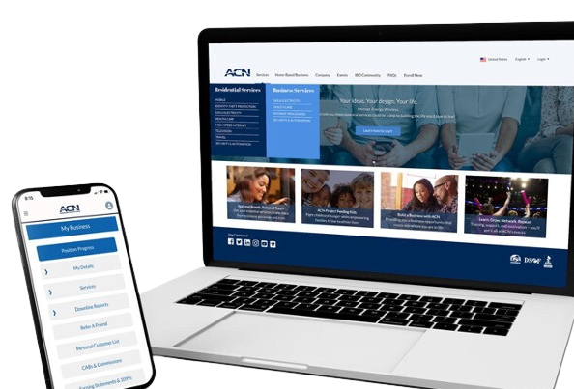
BECOME an Independent Business Owner (IBO)
$299 Start-Up + $25/month Business Support
All we do:
Personalized Website
Enroll customers
Help others to do the same thing
Training and Marketing Materials
Business Tracking and Reporting
IBO & Customer Support
ACN Loyalty Reward Program

Slide 9
Income from YOUR Personally Acquired Customers*
1
2
Monthly Customer Bonuses
Monthly Residual Income
Acquire Customers Totaling:
Earn Monthly On Your Customers
5 Services = $200
8 Services = $400
11 Services = $600
3% to 20%
Commissionable Revenue*
Plus $200
for Every Additional 3 Services*
Paid monthly on your customers Monthly Commissionable Revenue*
*Refer to the ACN Compensation Plan for complete details!

Slide 10
Income from YOUR Team’s Acquired Customers*
Overriding Customer Acquisition Bonuses
Earned once, when your team becomes customer qualified
CQ
ETL
RC
RD
RVP
SVP
SVP
Platinum
Up to
$150
Up to
$250
Up to
$350
Up to
$400
Up to
$450
$50
Overriding Residual Income
Paid monthly on customers your team enrolls
Up to
4%
Commissionable Revenue
*Refer to the ACN Compensation Plan for complete details!

Slide 11
I’m Ready To Get Started
Training & Support
ENROLL
AS AN IBO (Independent Business Owner)
Get with the person who invited you
and they’ll send you a link to their website!
PARTICIPATE
IN TRAINING
1
2
UTILIZE SUPPORT SYSTEM
ACN Online Presentations & Trainings
Your Team’s In-Person & Virtual Events
ACQUIRE
CUSTOMERS
&
BUILD A TEAM
3
4
IN BUSINESS FOR YOURSELF, NEVER BY YOURSELF!

Slide 12
Guests are welcome for all events.
New IBO Trainings are preceded by a short business overview.
The Healthcare Coverage informational Zoom will be followed by a short business overview
SUNDAY
MONDAY
TUESDAY
THURSDAY
SATURDAY
7:00 p.m. CT
7:00 p.m. CT
7:00 p.m. CT
7:00 p.m. CT
9:00 a.m. CT
NEW IBO TRAINING
HOW TO:
Get Qualified
Get Paid
Build Your Team
NEW IBO TRAINING
HOW TO:
Get Qualified
Get Paid
Build Your Team
Business Presentation
Invite Your Guests
Guests can register to attend at
HealthCoverageRedefined.com
IBOs Plug In
Every Sunday
Also great for guests!
Have a goal to have at least one guest on
each week!
New IBOs MUST be on this training as soon as they enroll!
Perfect for potential Impact customers.
Includes Q&A
New IBOs MUST be on this training as soon as they enroll!
RhinoNation.World
TheSVPSystem.com

Slide 14
&
NEW IBO TRAINING
The SYSTEM for how to maximize earnings for you and your team!
Earn Bonuses
Promote to First Leadership Position
Build Your Team
Supercharge Your Business

Slide 15
LAUNCH
LAUNCH Your Business
🗓️
📋
☎️
Set A Date In The
Next 24 – 48 Hours
Schedule Your
Business Launch NOW…
TEXT the person that invited you!
Pick A Time That
Works for YOU
Make A List.
100 names and numbers.
Do Not Prejudge!
Your “A” List
Business Owners
Network Marketing Experience
$100,000 Earners
Everyone Else
Invite, Invite, Invite...
50% Will Not Show
(OVER-INVITE)
Set a goal to have
double digit invites
The Person That Puts the Most People on Zoom Presentations the Fastest WINS
RhinoNation.World
TheSVPSystem.com
Notes:
Now that you know what to do, let's talk about how to do it.
LAUNCH YOUR BUSINESS!

Slide 16
THE PATH TO ETL
YOU Get
Teach and Help
To Do the Same
RhinoNation.World
TheSVPSystem.com

Slide 17
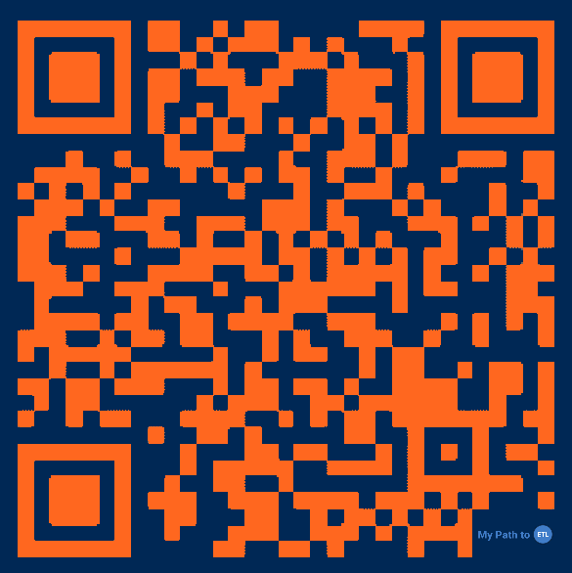
❗️Scan and Download Now❗️
MyPathToETL.com
Launch Your Business
Enroll Services
Become Customer Qualified (CQ)
Earn Your First Personal Customer Bonus - $200*
Build Your Team
Promote to ETL and Earn the ETL in 30 Days Bonus - $500*
Qualify for ETL Customer Acquisition Bonuses*
*Refer to the ACN compensation plan for complete details.
RhinoNation.World
TheSVPSystem.com

Slide 18
Sue
Bob
Mary
Jamal
Barb
Bryce
Zack
Jose
Alex
Miguel
Jim
Joe
Uncle fred
Aunt Key
Uncle Harry
Alec
Lisa
JT
Jimmy K
Bryson
Corey
Ranger
Aaron
Isabella
Marianna
You = 5 Services
Personal Customer Bonus
$200
Team = 10 Services
You – Electric
You – IDSeal
You – Truvvi
Total = 15 Services
ETL in 30 Days
$500
$700
Sue – Electric
Bryce – IDSeal
Zack
Barb
Electric
IDSeal
Truvvi
IMPACT
Flash
Electric
Impact
Flash
Flash
Dish
5
5
5
RhinoNation.World
TheSVPSystem.com
*See ACN Compensation Plan for full details. Your results may vary. Earnings are not guaranteed.

Slide 19
LAUNCH/GRAND OPENING SCRIPT
Works Well for a New IBO with little experience.
Hi, ________________. I just have a minute, but I wanted to call and let you know I started a business and I’m having an online launch/grand opening on (Day/Date/Time)_____________ and would love for you to attend just to support me. I just need to fill the Zoom with____ people so I can have a successful launch. It’s a quick 30 minutes and you can watch from home! Can I count on you to help me out and attend?
RhinoNation.World
TheSVPSystem.com

Slide 20
INVITATION - SAMPLE SCRIPT – PRACTICE IT!
Start by asking:
“Do you keep your options open for making additional income?”
Share
Show
Only
Just
May
May Not
Two
Choices
RhinoNation.World
TheSVPSystem.com

Slide 21
😎
💥 Be New
💥 Talk about a person, not the thing
💥 Essential Services
💥 3-Way Call
😬
What If They Have Questions…
RhinoNation.World
TheSVPSystem.com

Slide 22
Your
Business Launch
RhinoNation.World
TheSVPSystem.com

Slide 23
Launch Checklist
Send a Text Reminder TO YOUR GUESTS At Least 2 hours prior 15 minutes prior for Zoom
Well-Lit Room LIGHTS ON Home Ready for Guests
Professional Background CAMERA ON! Your Guests are watching you
Test MICROPHONE & WEBCAM
For Zoom Launch
Role of Host FILL THE ZOOM & INTRODUCE the speaker and opportunity with enthusiasm
Pay Attention TO THE SPEAKER! No distractions, no pets, no kids
RhinoNation.World
TheSVPSystem.com

Slide 24
YOUR FIRST ACN BUILDING BLOCK
$200
5 Services
+$500
$700
Zack
Barb
5 Services
5 Services
RhinoNation.World
TheSVPSystem.com
*See ACN Compensation Plan for full details.
Your results may vary. Earnings are not guaranteed.
Notes:
Quick Start
Build Confidence - You and Company
Get Paid
$500 Bonus for enrolling 30 customers between you and your team
Specifics from the person who enrolled you or invited you.
*****Now that you know what to do, let's talk about how to do it.

Slide 25
CONGRATULATIONS!!!
ETL
RC
RD
$50
$150
$250
5 Services
5 Services
$50
$150
$250
$50
$150
$250
5 Services
5 Services
$50
$150
$250
$50
$150
$250
$50
$150
$250
5 Services
5 Services
RhinoNation.World
TheSVPSystem.com
*See ACN Compensation Plan for full details.
Your results may vary. Earnings are not guaranteed.
Notes:
Quick Start
Build Confidence - You and Company
Get Paid
$500 Bonus for enrolling 30 customers between you and your team
Specifics from the person who enrolled you or invited you.
*****Now that you know what to do, let's talk about how to do it.

Slide 26
ACQUIRE CUSTOMERS
RhinoNation.World
TheSVPSystem.com
Notes:
Your goal when you get started is to get in the black ASAP

Slide 27
Monthly Personal Customer Bonuses
(Based off any Customers YOU Acquire)*
5 Services & 10 Points = $200
8 Services & 16 Points = $400
11 Services & 22 points = $600
PLUS $200 for Every Additional
3 Services & 6 Points
RhinoNation.World
TheSVPSystem.com
*Refer to the ACN Compensation Plan for complete details!
Notes:
Your goal when you get started is to get in the black ASAP

Slide 28
Sources for Customers
Who can become your customer?
YOU
Prospects Who Don’t Become IBOs
People You Do Business With
Family
&
Friends
RhinoNation.World
TheSVPSystem.com
Notes:
Four Sources of Customers
The Most Important Customer is YOU

Slide 29
How to Get Additional Customers…
Ask for favor
Favor
Why
Friends and Family
Favor-Why-Help-Try
Can you do me a small favor and try a service. I started a side business to get out of debt. Can I count on your help?
Help
Try
RhinoNation.World
TheSVPSystem.com

Slide 30
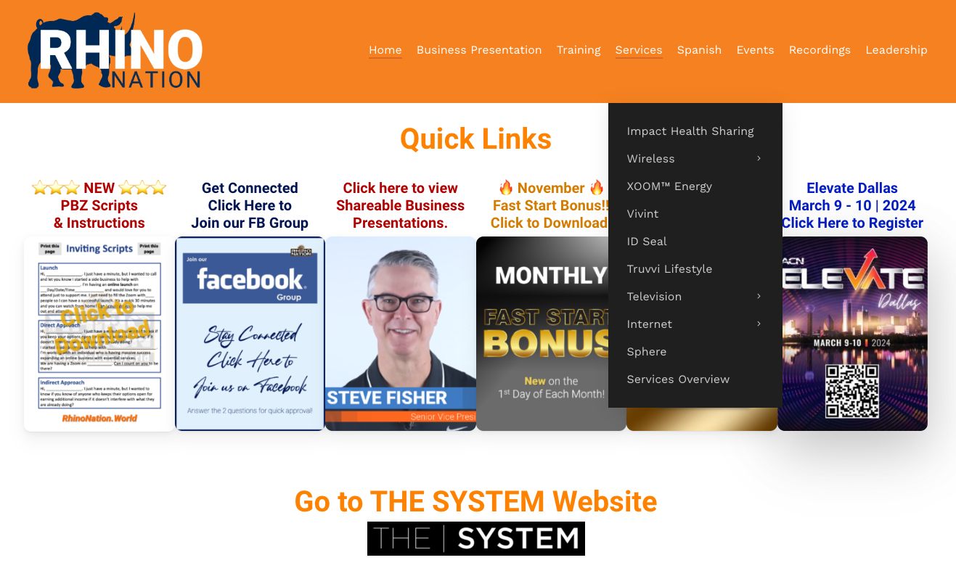
Become Impact & Energy Accredited
Go to:
RhinoNation.World > Services
Scroll to “How to Get Impact Accredited” then “How to Get Energy Accredited”
RhinoNation.World
TheSVPSystem.com
Notes:
Before you can sell Impact you need to become accredited
You also need to become Energy Accredited
Process for both is simple and easy.
Purpose is to give you a basic understanding of the services and ability to guide your customers to the right places for more information

Slide 31
Mindset
RhinoNation.World
TheSVPSystem.com

Slide 32
BE A PROFESSIONAL SORTER
Sorting is Fun! No one likes being convinced Be a Professional Listen, Sort and Move On SW, SW, SW, SW, NEXT!
Some Will, Some Won’t, So What, Someone’s Waiting!
RhinoNation.World
TheSVPSystem.com

Slide 33
IBOs WITH A START DATE IN APRIL 2024

Slide 34
How to Become an
ETL Factory
Wednesday @ 7:00 pm. CT in our FB Group
RhinoNation.World
TheSVPSystem.com

Slide 35
CALL TO ACTION!
🏆
1
2
3
Set up your
BUSINESS LAUNCH
HOME or ZOOM
Invite your guests to your LAUNCH.
Use the scripts provided on
RhinoNation.World
Identify and Acquire your first
5 SERVICES
right away and
BUILD YOUR TEAM
RhinoNation.World
TheSVPSystem.com

Slide 36
GET CONNECTED
GET
CONNECTED

Slide 37
Guests are welcome for all events.
New IBO Trainings are preceded by a short business overview.
The Healthcare Coverage informational Zoom will be followed by a short business overview
SUNDAY
MONDAY
TUESDAY
THURSDAY
SATURDAY
7:00 p.m. CT
7:00 p.m. CT
7:00 p.m. CT
7:00 p.m. CT
9:00 a.m. CT
NEW IBO TRAINING
HOW TO:
Get Qualified
Get Paid
Build Your Team
NEW IBO TRAINING
HOW TO:
Get Qualified
Get Paid
Build Your Team
Business Presentation
Invite Your Guests
Guests can register to attend at
HealthCoverageRedefined.com
IBOs Plug In
Every Sunday
Also great for guests!
Have a goal to have at least one guest on
each week!
New IBOs MUST be on this training as soon as they enroll!
Perfect for potential Impact customers.
Includes Q&A
New IBOs MUST be on this training as soon as they enroll!
RhinoNation.World
TheSVPSystem.com

Slide 38
JOIN US AT OUR NATIONAL CONVENTION
RhinoNation.World
TheSVPSystem.com

Slide 39
Thank You!

