Slide 1
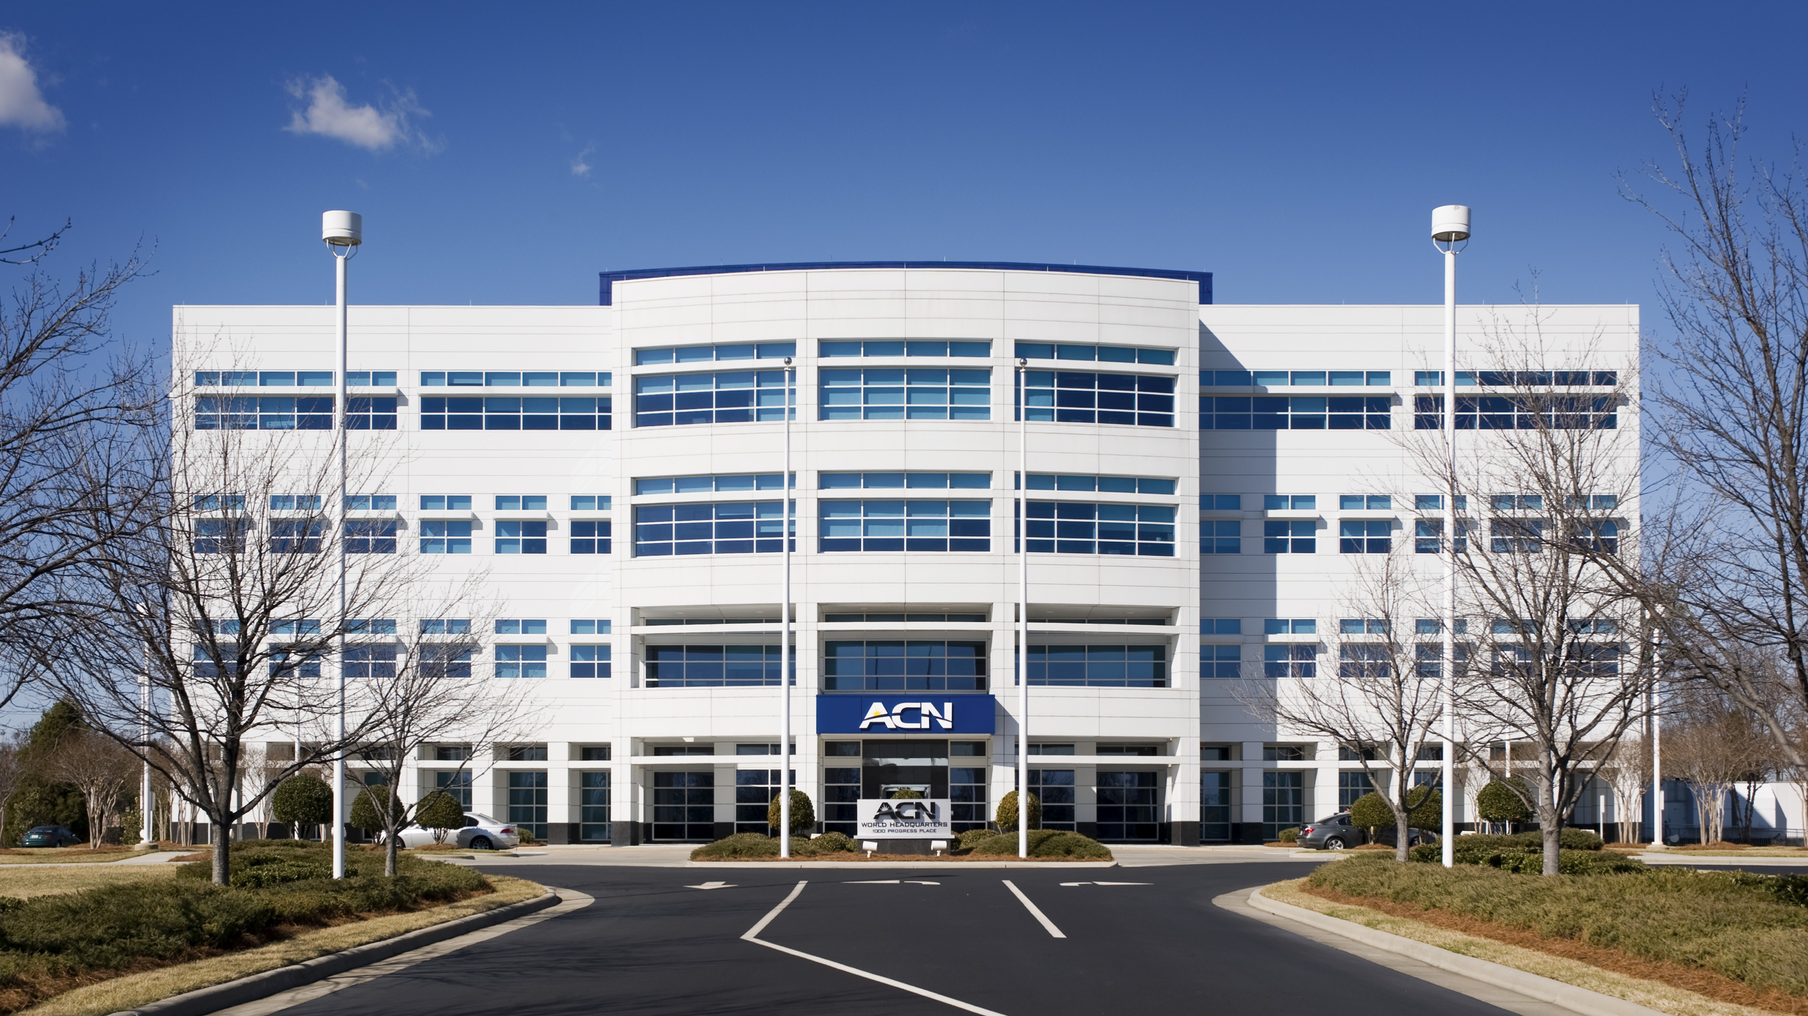

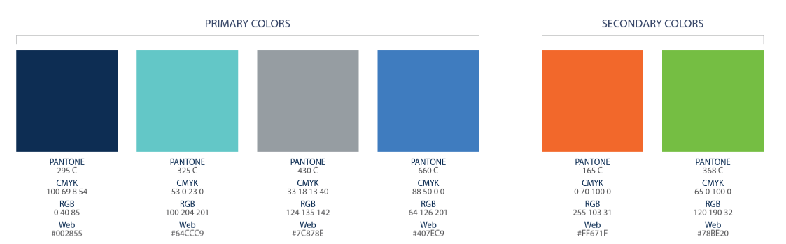

Slide 2
Refer to the ACN Compensation Plan for complete details. Earnings as an ACN IBO are based solely upon the successful sale of products to customers and their usage of those products. Individuals will incur expenses in operating their ACN business, such as the sign-up and monthly business support fees, as well as other possible operating expenses. As with any business, earnings and success at ACN are not guaranteed but depend primarily on the individual’s persistence, effort and results of acquiring customers personally and/or through their team. Individuals will not earn income and will lose money as an IBO if customers are not acquired.

Slide 3





Customer Acquisition
Specialists
Established
In 1993
Millions of
Customers Acquired
Billions
In Sales

Slide 4





Customer Acquisition
Specialists
Established
In 1993
Millions of
Customers Acquired
Billions
In Sales

Slide 5
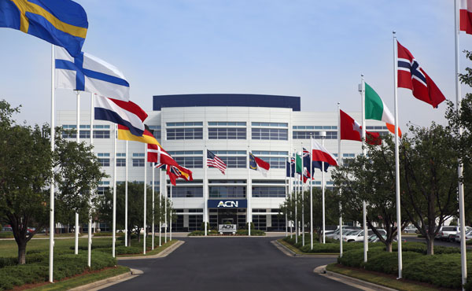




















ESSENTIAL SERVICES
Residential|Business
Trusted Partners
TELEVISION
TELEVISION
ENERGY
ENERGY
HIGH SPEED
INTERNET
HIGH SPEED
INTERNET
HEALTH
COVERAGE
HEALTH
COVERAGE
MOBILE
MOBILE
SECURITY &
AUTOMATION
SECURITY &
AUTOMATION
CLOUD SOLUTIONS
CLOUD SOLUTIONS
PAYMENT
PROCESSING
PAYMENT
PROCESSING
PAYROLL
SOLUTIONS
PAYROLL
SOLUTIONS
TRAVEL
TRAVEL
ID THEFT
PROTECTION
ID THEFT
PROTECTION

Slide 6


EARN BONUSES
To Cover Your Services*
REFER-A-FRIEND
POWERUP
REFER-A-FRIEND
Refer 12+ XOOM Energy Residential
Natural Gas or 12+ XOOM Energy Electricity customers and receive a bonus equal to the average commodity-only charges of your customers’ bills.
Enroll & authenticate 5+ customers with an IDSeal Annual plan and receive a bonus equal to the cost of your Annual service.*
Refer 5+ Flash Mobile customers and earn a FREE** line of service.
IMAGINE HOW MUCH YOU CAN SAVE YEAR AFTER YEAR!
*Refer to the ACN Compensation Plan for complete details!
**Excludes taxes and surcharges. Terms and conditions apply.

Slide 7







TRADITIONAL
BUSINESS MODEL
YOU
Most Service Providers
Media & Online Marketing
CUSTOMERS
Income Opportunity for You
More Choices for Consumers

Slide 8



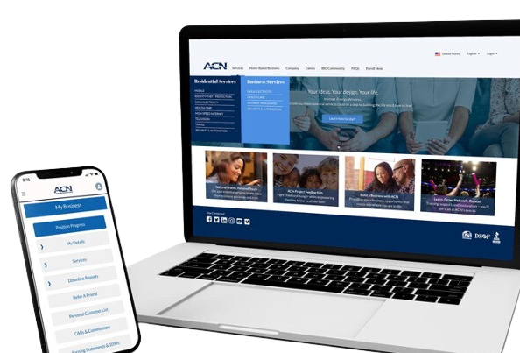



BECOME an Independent Business Owner (IBO)
$299 Start-Up + $25/month Business Support
All we do:
Personalized Website
Enroll customers
Help others to do the same thing
Training and Marketing Materials
Business Tracking and Reporting
IBO & Customer Support
ACN Loyalty Reward Program

Slide 9
Income from YOUR Personally Acquired Customers*
1
2
Monthly Customer Bonuses
Monthly Residual Income
Acquire Customers Totaling:
Earn Monthly On Your Customers
5 Services = $200
8 Services = $400
11 Services = $600
3% to 20%
Commissionable Revenue*
Plus $200
for Every Additional 3 Services*
Paid monthly on your customers Monthly Commissionable Revenue*
*Refer to the ACN Compensation Plan for complete details!

Slide 10

Income from YOUR Team’s Acquired Customers*
Overriding Customer Acquisition Bonuses
Earned once, when your team becomes customer qualified
CQ
ETL
RC
RD
RVP
SVP
SVP
Platinum
Up to
$150
Up to
$250
Up to
$350
Up to
$400
Up to
$450
$50
Overriding Residual Income
Paid monthly on customers your team enrolls
Up to
4%
Commissionable Revenue
*Refer to the ACN Compensation Plan for complete details!

Slide 11
I’m Ready To Get Started
Training & Support
ENROLL
AS AN IBO
(Independent Business Owner)
Get with the person who invited you
and they’ll send you a link to their website!
PARTICIPATE
IN TRAINING
1
2
UTILIZE SUPPORT SYSTEM
ACN Online Presentations
& Trainings
Your Team’s In-Person & Virtual Events
ACQUIRE
CUSTOMERS
&
BUILD A TEAM
3
4
IN BUSINESS FOR YOURSELF, NEVER BY YOURSELF!

Slide 13









&
NEW IBO TRAINING
The SYSTEM for how to maximize earnings for you and your team!
Earn Bonuses
Promote to First Leadership Position
Build Your Team
Supercharge Your Business

Slide 14

&
Guided Enrollment
Important Links to Bookmark
Critical “To Do” Items
Team Events
***Access to Team Emails
RhinoNation.World

Slide 15




🏠
🗓️
Home Event
Build Relationships
Fluid Conversations
Networking
Follow Up Conversations
Relaxed Environment
Virtual Event
Attendees can join from a distance
Less time-consuming
Attendees can watch from home
Weather is not an issue
Set A Date In The
Next 24 – 48 Hours
Pick A Time That
Works for YOU
LAUNCH
Your Business
Your “A” List
Business Owners
Network Marketing Experience
$100,000 Earners
Everyone Else
RhinoNation.World
TheSVPSystem.com
Notes:
Now that you know what to do, let's talk about how to do it.
LAUNCH YOUR BUSINESS!

Slide 16


THE PATH TO ETL
YOU Get
Teach and Help
To Do the Same
RhinoNation.World
TheSVPSystem.com

Slide 17
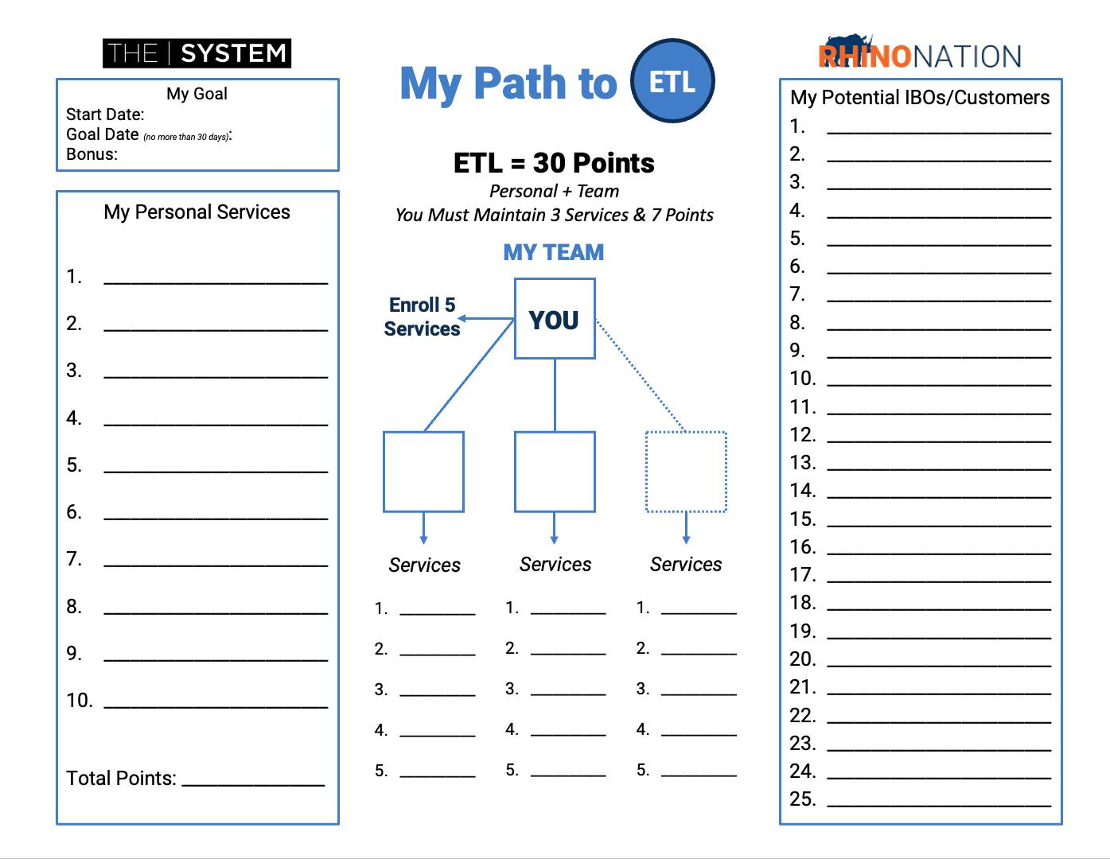
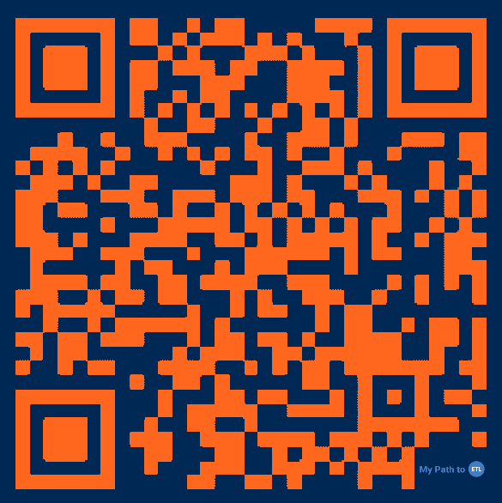
❗️Scan and Download Now❗️
MyPathToETL.com
Launch Your Business
Enroll Services
Become Customer Qualified (CQ)
Earn Your First Personal Customer Bonus - $200*
Build Your Team
Promote to ETL and Earn the ETL in 30 Days Bonus - $500*
Qualify for ETL Customer Acquisition Bonuses*
*Refer to the ACN compensation plan for complete details.
RhinoNation.World
TheSVPSystem.com

Slide 18
Sue
Bob
Mary
Jamal
Barb
Bryce
Zack
Jose
Alex
Miguel
Jim
Joe
Uncle fred
Aunt Key
Uncle Harry
Alec
Lisa
JT
Jimmy K
Bryson
Corey
Ranger
Aaron
Isabella
Marianna
You = 5 Services
Personal Customer Bonus
$200
Team = 10 Services
You – Electric
You – IDSeal
You – Truvvi
Total = 15 Services
ETL in 30 Days
$500
$700
Sue – Electric
Bryce – IDSeal
Zack
Barb
Electric
IDSeal
Truvvi
IMPACT
Flash
Electric
Impact
Flash
Flash
Dish
5
5
5
RhinoNation.World
TheSVPSystem.com
*See ACN Compensation Plan for full details. Your results may vary. Earnings are not guaranteed.

Slide 19
LAUNCH/GRAND OPENING SCRIPT
Works Well for a New IBO with little experience.
Hi, ________________. I just have a minute, but I wanted to call and let you know I started a business and I’m having my launch/grand opening on (Day/Date/Time)_________ and would love for you to attend just to support me. I just need to have ____ people so I can have a successful launch. Can I count on you to help me out and attend?
RhinoNation.World
TheSVPSystem.com

Slide 20
INVITATION - SAMPLE SCRIPT – PRACTICE IT!
Start by asking:
“Do you keep your options open for making additional income?”
Share
Show
Only
Just
May
May Not
Two
Choices
RhinoNation.World
TheSVPSystem.com

Slide 21
😎
💥 Be New
💥 Talk about a person, not the thing
💥 Essential Services
💥 3-Way Call
😬
What If They Have Questions…
RhinoNation.World
TheSVPSystem.com

Slide 22
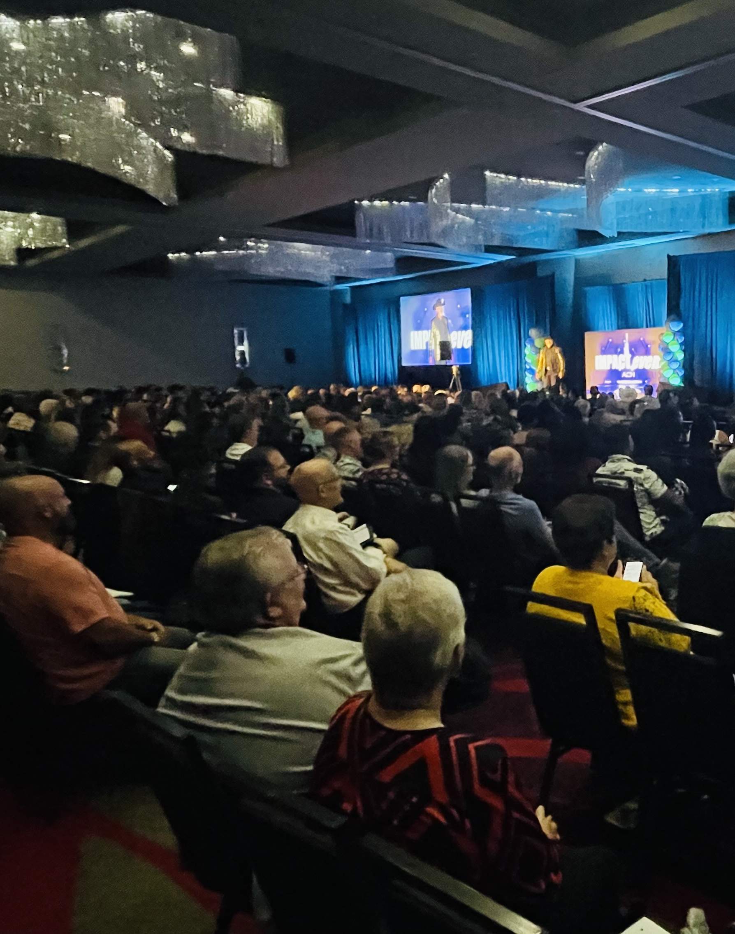
Your
Business Launch
RhinoNation.World
TheSVPSystem.com

Slide 23







Launch Checklist
Send a Text Reminder
TO YOUR GUESTS
At Least 2 hours prior
15 minutes prior for Zoom
Well-Lit Room
LIGHTS ON
Home Ready for Guests
Professional Background
CAMERA ON!
Your Guests are watching you
Test
ALL YOUR TECH
Mic/Web Cam or TV Connection
Role of Host
FILL THE EVENT & INTRODUCE the speaker and opportunity with enthusiasm
Pay Attention
TO THE SPEAKER!
No distractions,
no pets, no kids
RhinoNation.World
TheSVPSystem.com

Slide 24




YOUR FIRST ACN BUILDING BLOCK
$200
5 Services
+$500
$700
Zack
Barb
5 Services
5 Services
RhinoNation.World
TheSVPSystem.com
*See ACN Compensation Plan for full details.
Your results may vary. Earnings are not guaranteed.
Notes:
Quick Start
Build Confidence - You and Company
Get Paid
$500 Bonus for enrolling 30 customers between you and your team
Specifics from the person who enrolled you or invited you.
*****Now that you know what to do, let's talk about how to do it.

Slide 25




CONGRATULATIONS!!!
ETL
$50
5 Services
5 Services
$50
$50
5 Services
5 Services
$50
$50
$50
5 Services
5 Services
RhinoNation.World
TheSVPSystem.com
*See ACN Compensation Plan for full details.
Your results may vary. Earnings are not guaranteed.
Notes:
Quick Start
Build Confidence - You and Company
Get Paid
$500 Bonus for enrolling 30 customers between you and your team
Specifics from the person who enrolled you or invited you.
*****Now that you know what to do, let's talk about how to do it.

Slide 26


ACQUIRE CUSTOMERS
RhinoNation.World
TheSVPSystem.com
Notes:
Your goal when you get started is to get in the black ASAP

Slide 27
Monthly Personal Customer Bonuses
(Based off any Customers YOU Acquire)*
5 Services & 10 Points = $200
8 Services & 16 Points = $400
11 Services & 22 points = $600
PLUS $200 for Every Additional
3 Services & 6 Points
RhinoNation.World
TheSVPSystem.com
*Refer to the ACN Compensation Plan for complete details!
Notes:
Your goal when you get started is to get in the black ASAP

Slide 28

Sources for Customers
Who can become your customer?
YOU
Prospects Who Don’t Become IBOs
People You Do Business With
Family
&
Friends
RhinoNation.World
TheSVPSystem.com
Notes:
Four Sources of Customers
The Most Important Customer is YOU

Slide 29

How to Get Additional Customers…
Ask for favor
Favor
Why
Friends and Family
Favor-Why-Help-Try
Can you do me a small favor and try a service. I started a side business to get out of debt. Can I count on your help?
Help
Try
RhinoNation.World
TheSVPSystem.com

Slide 30
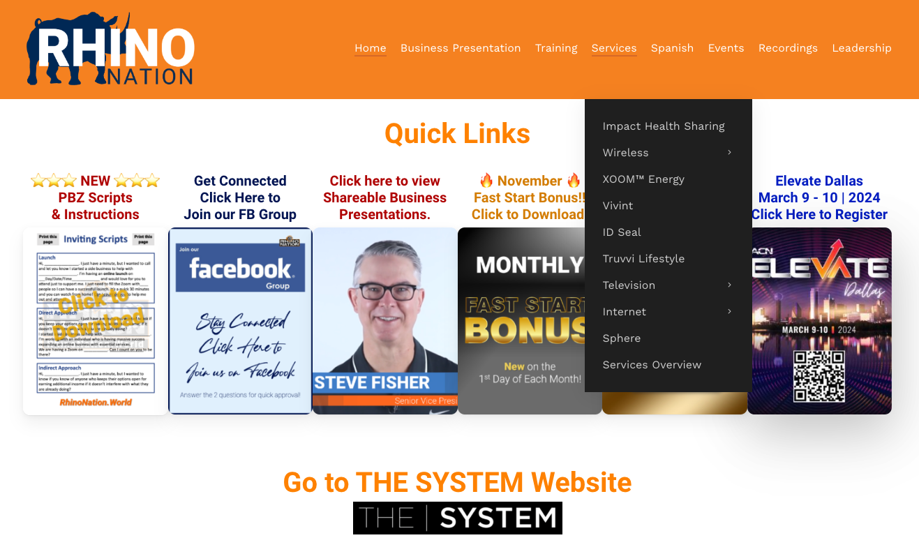
Become Impact & Energy Accredited
Go to:
RhinoNation.World > Services
Scroll to “How to Get Impact Accredited” then “How to Get Energy Accredited”
RhinoNation.World
TheSVPSystem.com
Notes:
Before you can sell Impact you need to become accredited
You also need to become Energy Accredited
Process for both is simple and easy.
Purpose is to give you a basic understanding of the services and ability to guide your customers to the right places for more information

Slide 31
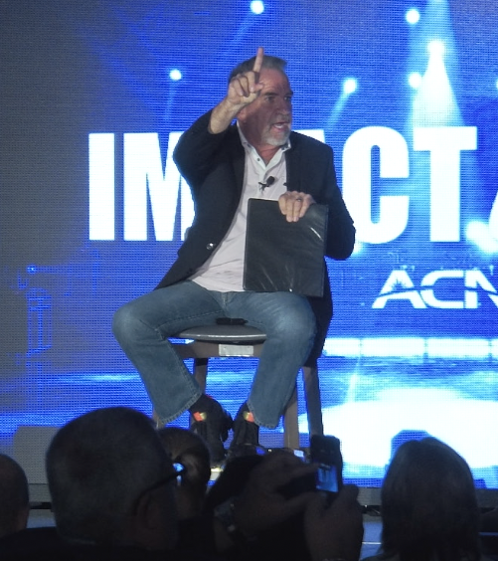
Mindset
RhinoNation.World
TheSVPSystem.com

Slide 32

BE A PROFESSIONAL SORTER
Sorting is Fun!
No one likes being convinced
Be a Professional
Listen, Sort and Move On
SW, SW, SW, SW, NEXT!
Some Will, Some Won’t, So What, Someone’s Waiting!
RhinoNation.World
TheSVPSystem.com

Slide 33
CONGRATULATIONS!!!
ETL
RC
$50
$150
5 Services
5 Services
$50
$150
$50
$150
5 Services
5 Services
$50
$150
$50
$150
$50
$150
5 Services
5 Services
RhinoNation.World
TheSVPSystem.com
*See ACN Compensation Plan for full details.
Your results may vary. Earnings are not guaranteed.
Notes:
Quick Start
Build Confidence - You and Company
Get Paid
$500 Bonus for enrolling 30 customers between you and your team
Specifics from the person who enrolled you or invited you.
*****Now that you know what to do, let's talk about how to do it.

Slide 34
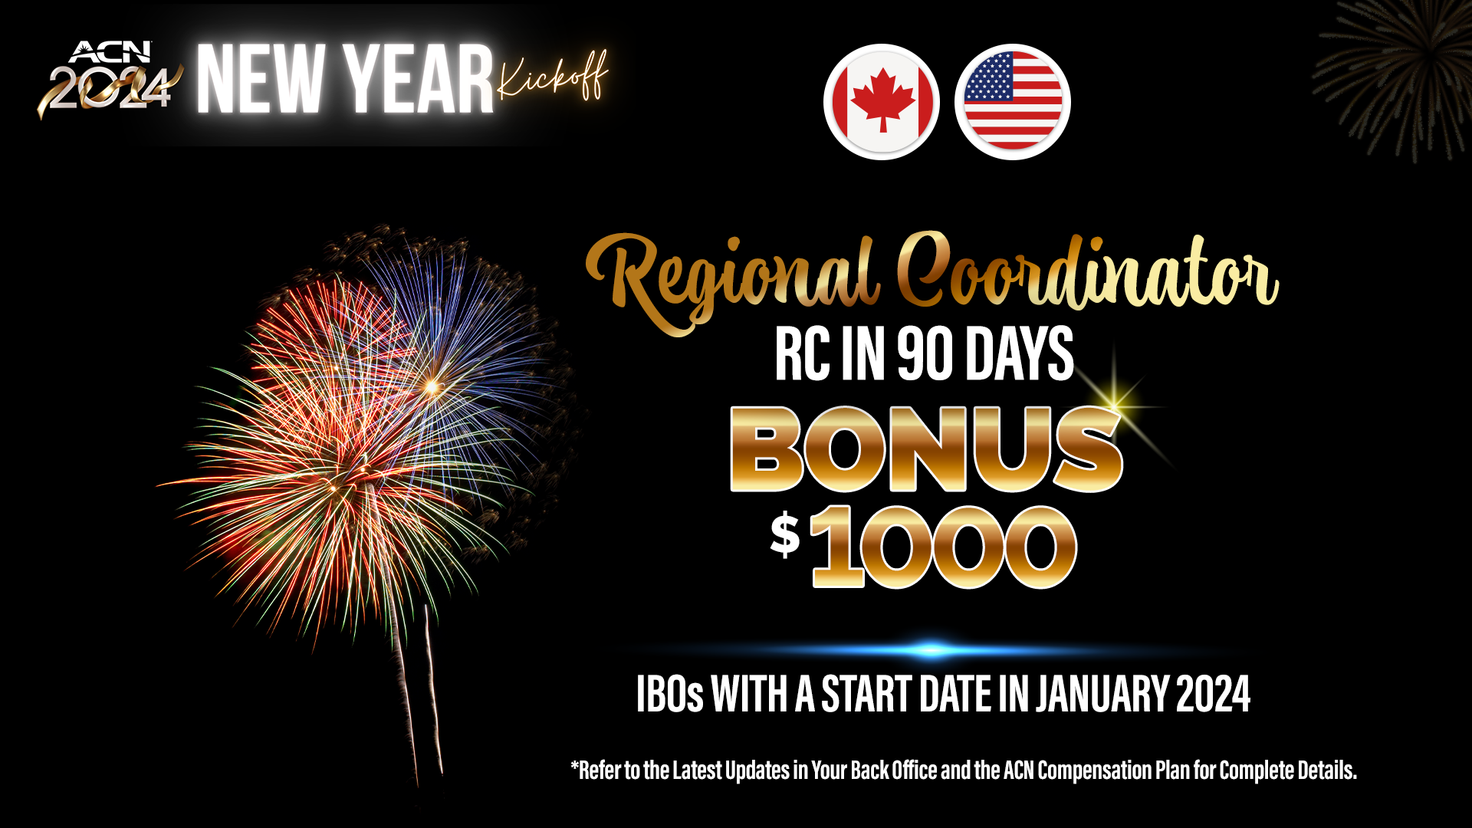
IBOs WITH A START DATE IN JULY 2024

Slide 35

How to Promote to
Regional Coordinator
Wednesday @ 7:00 pm. CT in our FB Group
RhinoNation.World
TheSVPSystem.com

Slide 36


GET CONNECTED
GET
CONNECTED

Slide 37

CALL TO ACTION!
🏆
1
2
3
Set up your
BUSINESS LAUNCH
HOME or ZOOM
Invite your guests to your LAUNCH.
Use the scripts provided on
RhinoNation.World
Identify and Acquire your first
5 SERVICES
right away and
BUILD YOUR TEAM
RhinoNation.World
TheSVPSystem.com

Slide 38





Guests are welcome for all events.
New IBO Trainings are preceded by a short business overview.
The Healthcare Coverage informational Zoom will be followed by a short business overview
SUNDAY
MONDAY
TUESDAY
THURSDAY
SATURDAY
7:00 p.m. CT
7:00 p.m. CT
7:00 p.m. CT
7:00 p.m. CT
9:00 a.m. CT
NEW IBO TRAINING
HOW TO:
Get Qualified
Get Paid
Build Your Team
NEW IBO TRAINING
HOW TO:
Get Qualified
Get Paid
Build Your Team
Business Presentation
Invite Your Guests
Guests can register to attend at
HealthCoverageRedefined.com
IBOs Plug In
Every Sunday
Also great for guests!
Have a goal to have at least one guest on
each week!
New IBOs MUST be on this training as soon as they enroll!
Perfect for potential Impact customers.
Includes Q&A
New IBOs MUST be on this training as soon as they enroll!
RhinoNation.World
TheSVPSystem.com

Slide 39
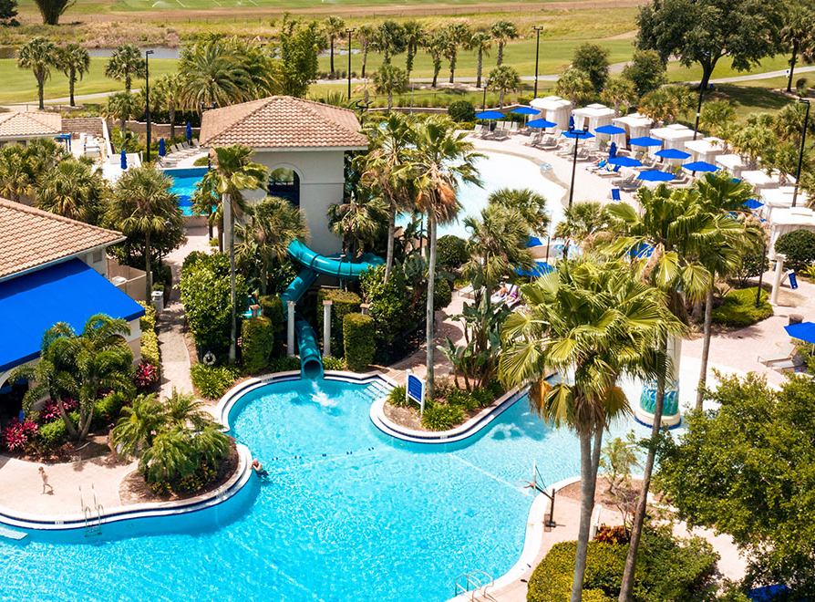


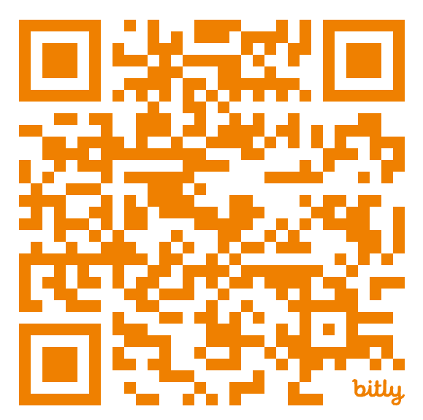



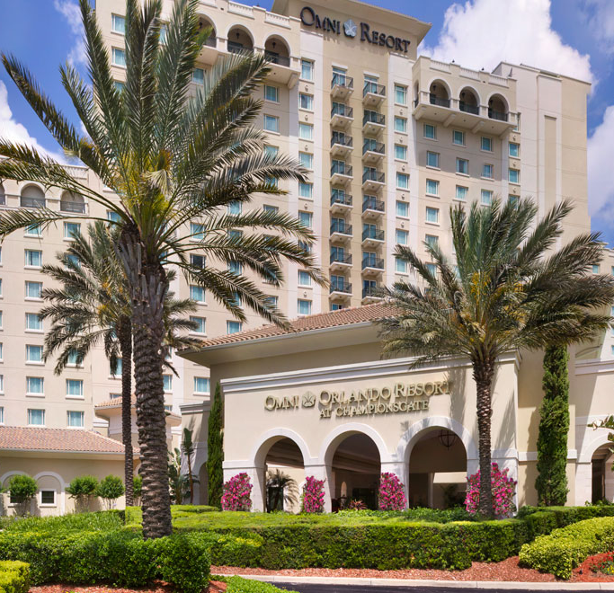
ORLANDO
October 12 – 13, 2024
www.ACNElevate.com

Slide 40


Thank You!

